Slide 1
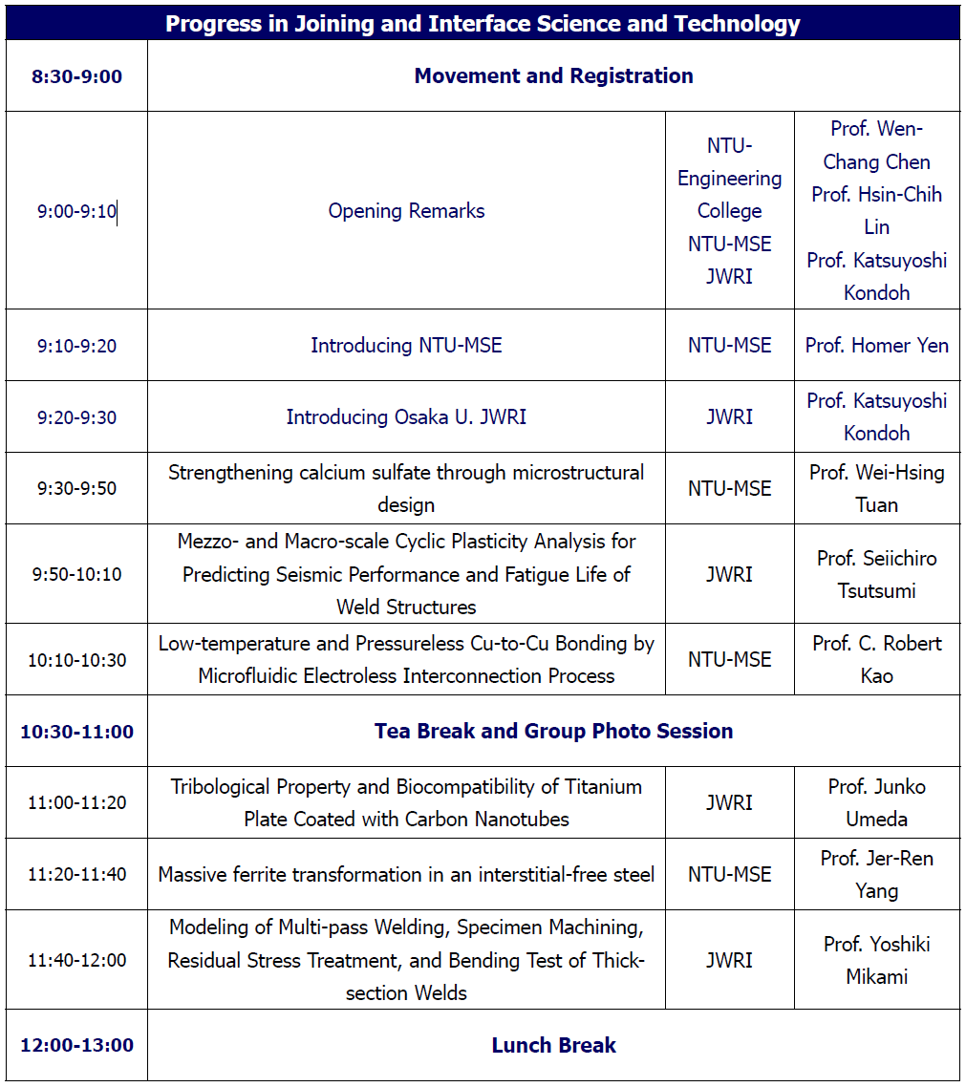
The 4th Osaka University-JWRI/NTU-MSE Workshop
7th March 2019 in Taipei, Taiwan
Morning Session

Slide 2
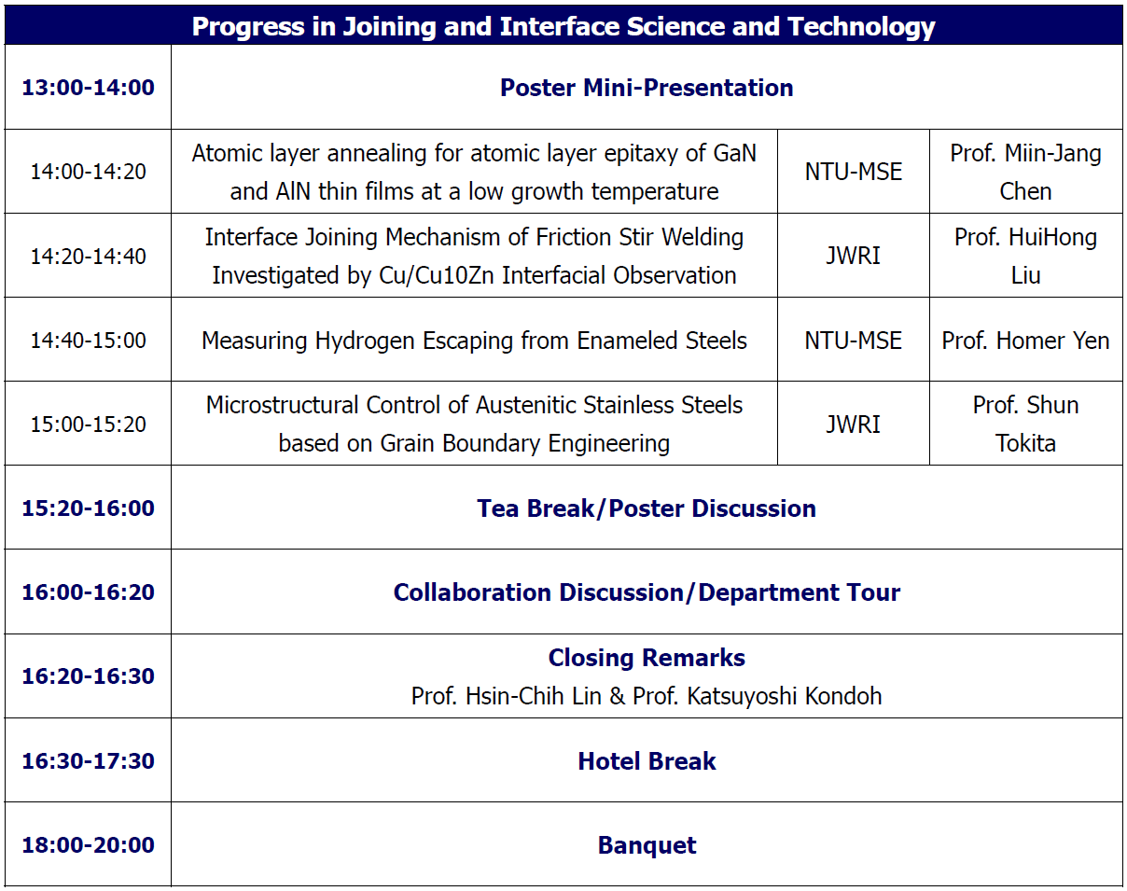
The 4th Osaka University-JWRI/NTU-MSE Workshop
7th March 2019 in Taipei, Taiwan
Afternoon Session

